Slide 1
Fixing duplicate interviews - Deleting vs. modifying interviews
Ghana Malaria Indicator Survey

Slide 2
Problem 1: Same woman entered (interviewed) twice by two different team members.
The problem is detected after the supervisor receives the work from different interviewers (option 4) and/or when trying to “close the cluster” (option 7).

Slide 3
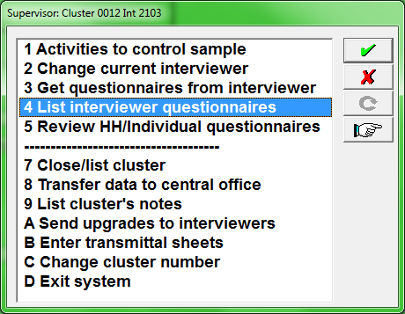
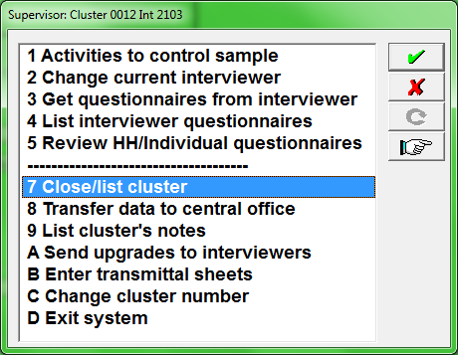
The problem is detected…
=> Search for a solution

Slide 4
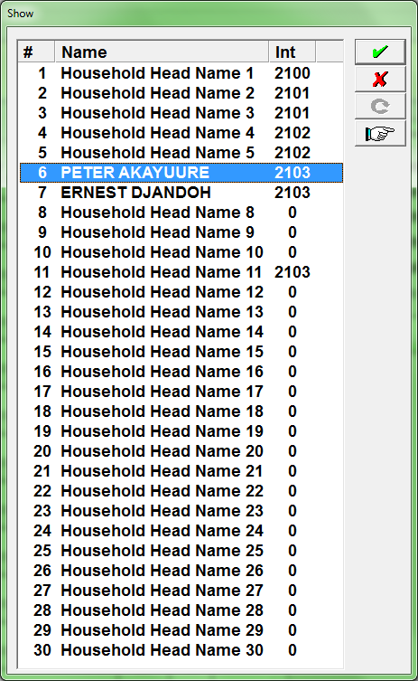
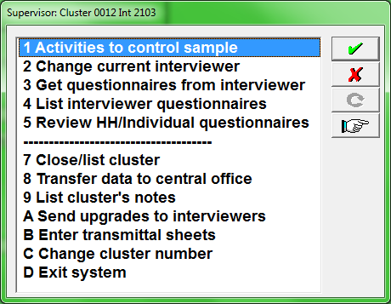
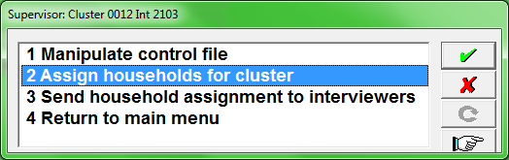
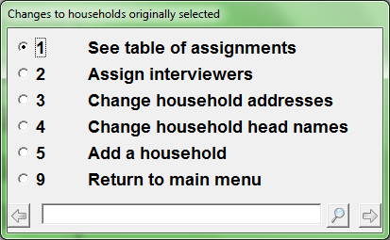
How to solve:
1. Write down ids: cluster, hh, line#, fw codes
2. Open table of assignments to see to whom the HH was assigned to

Slide 5
3. Discuss the issue among the interviewers who are responsible for the duplicates
For our case yesterday, it was determined that duplication occurred after sharing the household with another team member so the other team member can help interviewing the eligible woman.
Solution is always implemented on the tablet where the duplicate case must be corrected and using the interviewer menu.
In this case, we penalized the interviewer who shared the household because he has agreed with the other interviewer to transfer the household data so he can be helped. Thus, he should not have to interview the woman a second time.
In a real work situation, this is unlikely to happen, but possible. The respondent may react informing the second interviewer that she has already been interviewed.

Slide 6
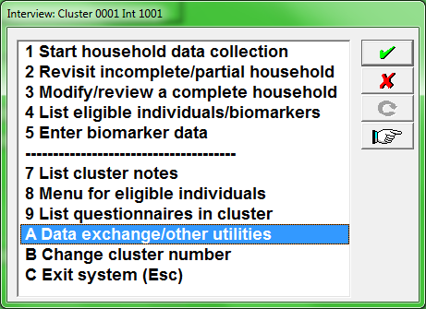
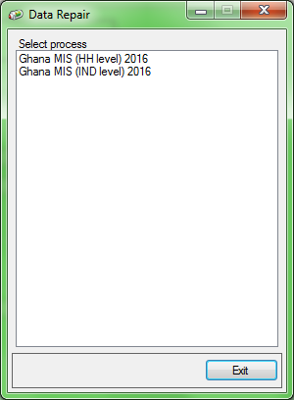
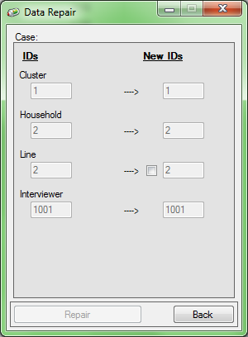
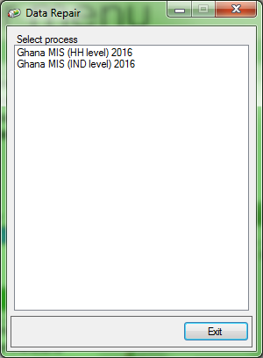
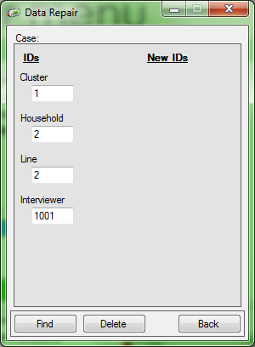
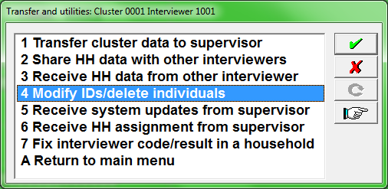
Interviewer menu

Slide 7
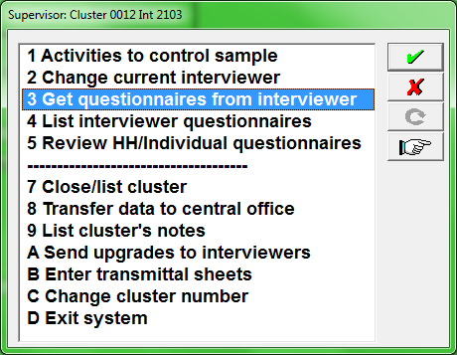
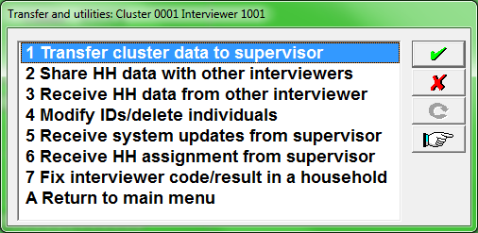
Interviewer + Supervisor menus

Slide 8
Problem 2: two duplicate HHs by two different team members.
The problem is detected after the supervisor receives the work from different interviewers (option 4) and/or when trying to “close the cluster” (option 7).

Slide 9
The problem is detected…
=> Search for a solution

Slide 10
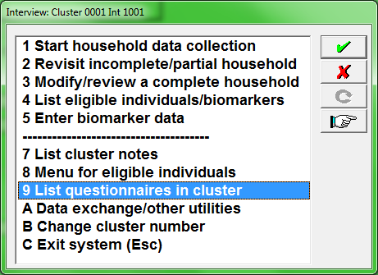
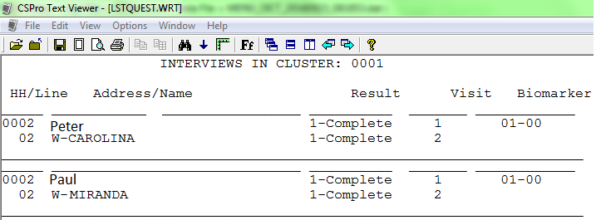
How to solve:
1. Write down ids: cluster, hh, fw codes, and notice that the NAMES OF THE HEAD OF THE HOUSEHOLD ARE DIFFERENT
2. To check the status of these duplicated household, each interviewer that have the duplicate cases run option 9 “LIST QUESITONNAIRE IN CLUSTER” from interviewer menu

Slide 11
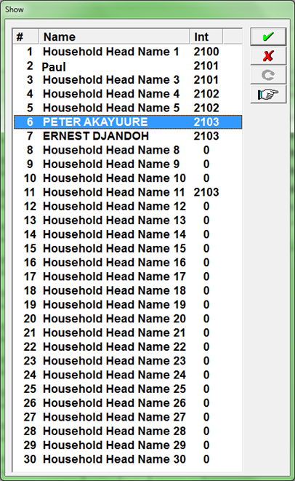
How to solve cont.
3. Open table of assignments to see to whom the HH was assigned to

Slide 12
3. Discuss the issue among the interviewers who are responsible for the duplicates
For our case yesterday, it was determined that duplication occurred after interviewer wrongly used HH IDs not assigned to him, for example, used HH 0002 instead of 0006. So, we penalized that interviewer that should have used HH ID 0006 and he must correct in his tablet.
Solution is always implemented on the tablet where the duplicate case must be corrected and using the interviewer menu.
In a real work situation, this is unlikely to happen, but possible. Why? Because the interviewer in fault should have used IDs for HOUSEHOLDS ASSIGNED TO ME, AND NOT IDS FOR HOUSEHOLDS ASSIGNED TO SOMEONE ELSE.

Slide 13
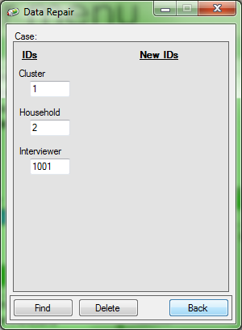
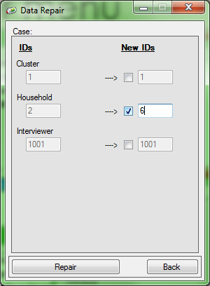
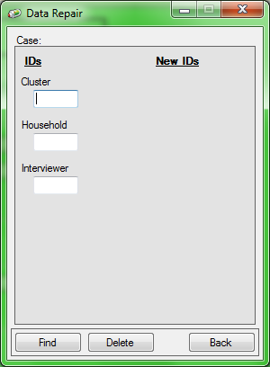
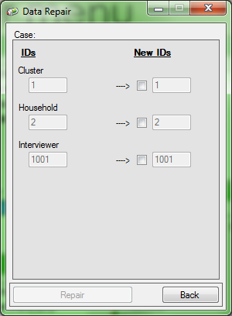
Interviewer menu

Slide 14
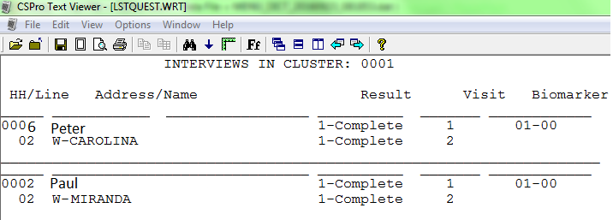
How to solve:
1. check the status of households by running option 9 “LIST QUESITONNAIRE IN CLUSTER” from interviewer menu

Slide 15
Interviewer + Supervisor menus

